Slide 1
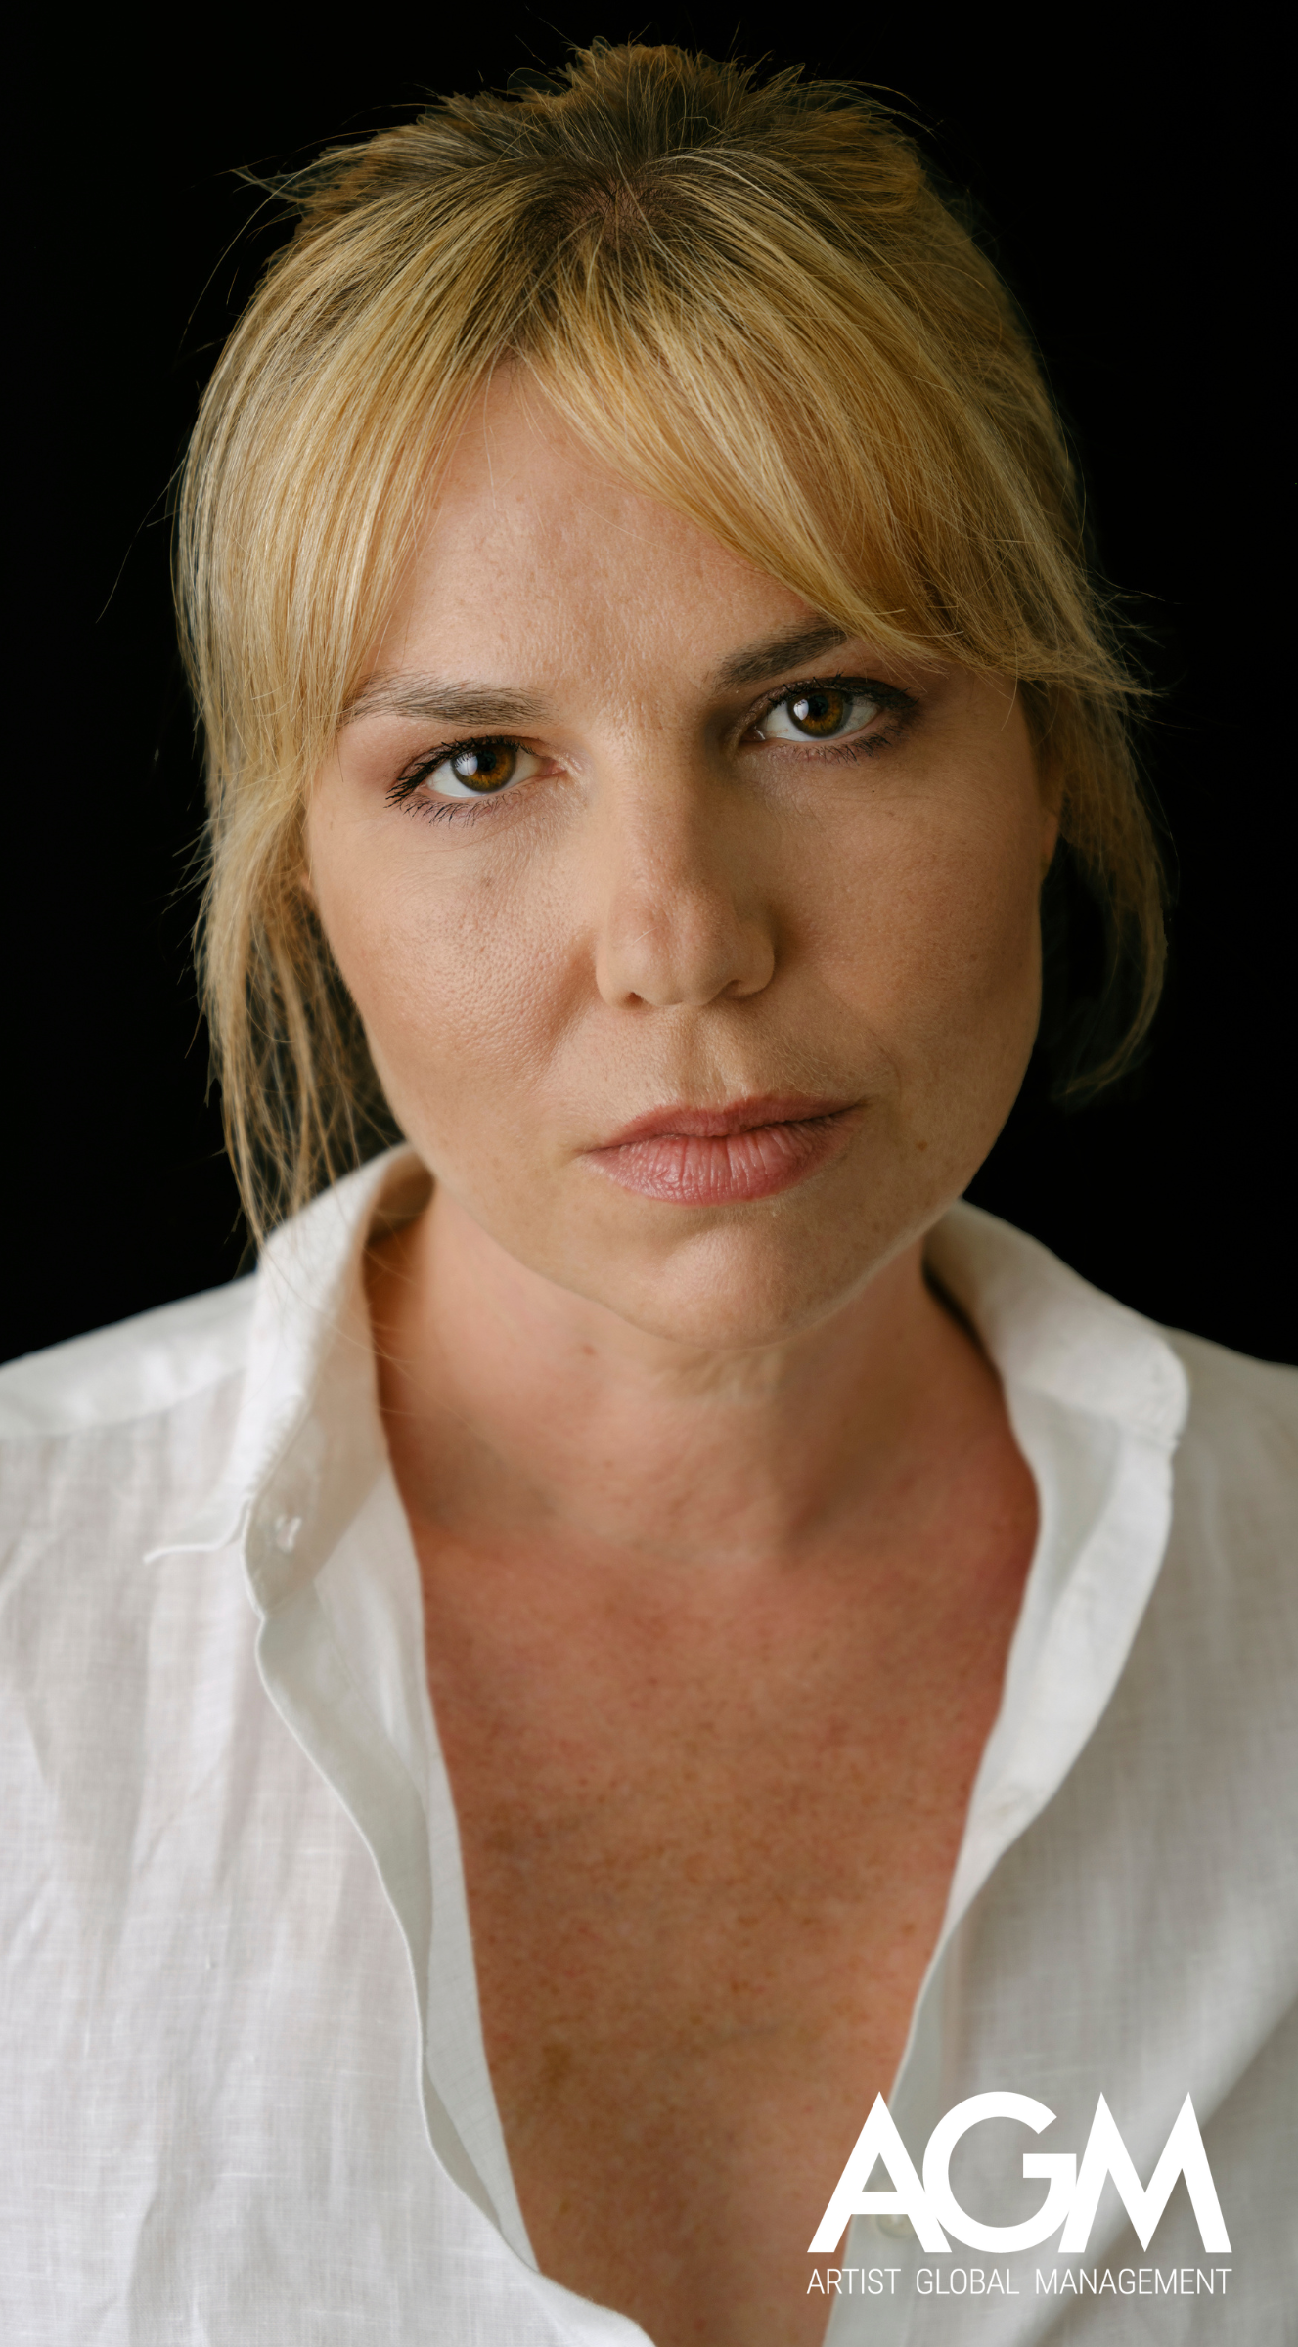
KATRIN
KAASA
STREAMING
2023, “Charité” - Season 4, series, co-production UFAFiction/Cinemate, Netflix
CINEMA
2022, “O Teu Rosto Será o Último”, Directed by Luís Filipe Rocha, Ukbar Filmes
2018, ”Submissão”, Directed by Leonardo António
2015, “O Dia do Meu Casamento”, Directed by Anabela Moreira and João Canijo, Midas Filmes
2014, “Time Zone”, Directed by Pedro Palma
2011, “Zoo”, Curta-Metragem, Directed by Margarida Leitão, Ukbar Filmes
2007, “Wrap-a-Round”, Short, Directed by Eduardo Abrantes, Produção CAM Gulbenkian
2006, “Do Outro Lado do Mundo”, Directed by Leandro Ferreira, Produção Continental Filmes
THEATER
2025, “Enciclopédia da Vida Sexual”, staging by Pedro Gil, CCB
2022, “A Reconquista de Olivenza”, staging by Ricardo Neves-Neves and Filipe Raposo, produced by Culturproject Nuno Pratas, São Luiz Teatro Municipal
2022, “Não me faças perder tempo”, Text by Luís António Coelho, Staging and Dramaturgy Rui Neto, Teatro Aberto
2021, “Cenas da Vida Conjugal", Staging by Rita Calçada Bastos, Close2Paradise, São Luiz Teatro Municipal - room Mário Viegas
2021, ”O Jardim das Cerejeiras”, by Anton Tchékov, Staging by José Peixoto, Produced by Teatro dos Aloés, Recreios da Amadora
CONTACTS
(351) 218 288 574
agm@artistglobalmanagement.com
artistglobalmanagement.com
CHARACTERISTICS
  Eyes: Brown
Hair: Brown
Height: 1,64m
LANGUAGES
Portuguese, Norwegian, English, French and German

Slide 2
KATRIN
KAASA
THEATER
2019, ”Ver Mais Sobre ti”, by Keli Freitas, Co-Creation by Katrin Kaasa, Keli Freitas, Rita Brütt and Vanda Cerejo for RTP2
2018, “Moving People”, by Chritiane Jatahy, City Museum
2017, “Filhos das Mães”, Staging by Martim Pedroso, Teatro São Luiz
2014, “Consegues ver os teus pés?”, Staging by Martim Pedroso, Teatro Taborda
2013, “Humor e Húmus", Staging by Ana Brito e Cunha, Quinta da Regaleira
2012, "Textos de Cordel”, Staged Reading by Natália Luíza, Teatro Nacional D.Maria II
2011, “A Visita", Staging by Natália Luíza, Teatro Nacional D. Maria II
2010, “Persona”, Staging by João Canijo (Brasil)
2010, “Um dia dancei SÓ dancei um dia”, Staging by Daniel Gorjão, Festival de Teatro de Almada
2009, Ensaio Amargo sobre Petra von Kant, Staging by Sophie Pinto, Teatro Bocage
2009, “Pessoa Revisited", Staging by Daniel Gorjão, Cine Teatro S. Pedro
2008, “Rock’n Roll”, Tom Stoppard, Staging by João Lourenço, Teatro Aberto
2007, “7 Monólogos”, Peer Gynt, Music by Grieg, Small Auditorium at CCB and in the Salão Nobre of Teatro Nacional D. Maria II
2007, “Fedra”, Jean Racine, Staging by Ana Támen, Teatro Maria Matos
2006, “E ele inquieto busca a tempestade como se na tempestade houvesse paz”, Text by Tchécov under the guidance of João Canijo in the New Actors Cycle, Teatro S. Luiz
2005/06, “Orgia”, Pier Paolo Pasolini, Staging by João Grosso, Teatro Nacional D. Maria II
2004/05, “Poder”, Nick Dear, Staging by Joaquim Benite, Teatro de Almada
2003/04, “O Bobo e a sua Mulher esta Noite na Pancomédia de Botho Strauss”, Staging by João Lourenço, Teatro Nacional S. João
2003, Participation in the XXX Show of the Fura del Baús, CCB
1995, Participation in the Festival Jovem, of the Festival d’Avignon (France)
TELEVISION
2024, "Senhora do Mar”, Soap Opera, SP Televisão, SIC
2021, “Encarregados de Educação”, TV Series, Directed by António Botelho, Produções Fictícias, RTP2
2021, “Quando o Diabo Reza", Television Film, Directed by Fabiana Tavares, Ukbar Filmes, RTP
2020, “Amar demais", Soap Opera, Plural, TVI (Special Appearance)
2019, “St.Louis - Enemy Aliens”, TV Film, Directed by Ben von Grafenstein (Co-Production Germany/ Portugal)
2018, “A Teia”, Soap Opera, Plural, TVI

Slide 3
KATRIN
KAASA
TELEVISION
2017, “Paixão”, Soap Opera, SP Televisão, SIC
2015, “A Única Mulher”, Soap Opera, Plural, TVI
2014, “Belmonte”, Soap Opera, Plural, TVI
2012, “E Depois Matei-o”, TV Film, Plural, RTP
2011, “Histórias para Sempre”, Mola Produções, RTP
2011, “Maternidade”, TV Series, SP Televisão, RTP
2011, “Amigos para Sempre”, TV Series, SP Televisão, RTP
2008/09, “Podia Acabar o Mundo", Soap Opera, SP Televisão, SIC
2008, “Liberdade 21”, TV Series, SP Televisão, RTP
VIDEO
2004, ”I’ll See You in My Dreams”, Videoclip Moonspell
2004, Installation Video / Performance Jardim da Sedução, by Jean-Luc Vilmouth, Bienal Luzboa, Teatro São Luiz
TRAINING
2009, Single Semester Classical Acting Course, LAMDA, London
2004/07, Training Course for Actors at the Escola Superior de Teatro e Cinema
2001/02, Training Course for Actors at ACT - Escola Actores para Cinema e Televisão
Workshops and Complementary Training with Christiane Jatahy, Sergio Penna, Nuno Nunes, Robert Castle, Beatriz Batarda, Lenard Petit, Meg Stuart, João Grosso, Marie Brand, Vladislav Pazi, Joana Craveiro, Tiago Rodrigues, among others

